Slide 1
Install XAMPP
https://www.apachefriends.org/zh_tw/download.html

Slide 2
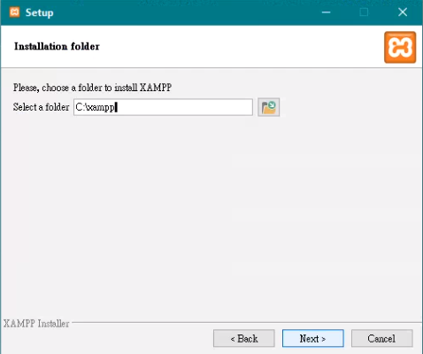

Slide 4
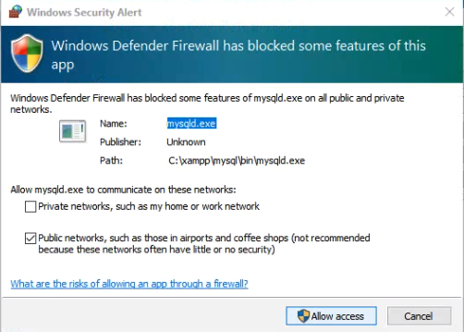

Slide 6
網址列輸入: localhost

Slide 7
網址列輸入 http://localhost/phpmyadmin/

