Slide 1
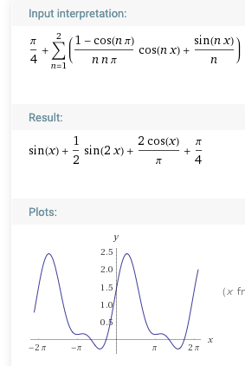
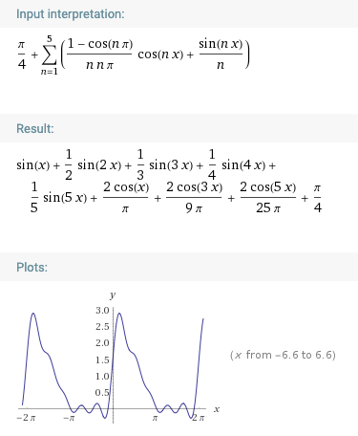
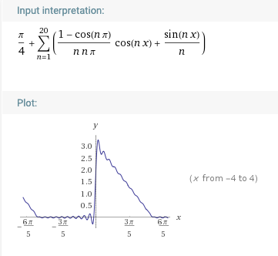
pi/4+ sum( ((1-cos(n*pi))/(n*n*pi))*cos(n*x) + (sin(n*x)/n) ), n=1 to 20
https://www.wolframalpha.com/input/?i=pi%2F4%2B+sum%28+%28%281-cos%28n*pi%29%29%2F%28n*n*pi%29%29*cos%28n*x%29+%2B+%28sin%28n*x%29%2Fn%29+%29%2C+n%3D1+to+5

Slide 2
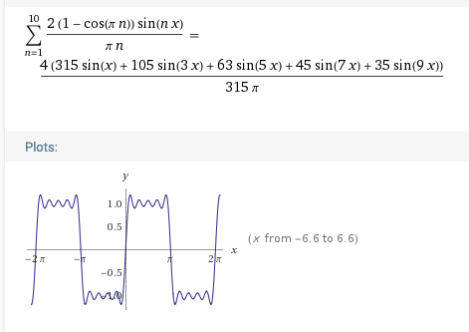
sum( (2/(n*pi))*(1-cos(n*pi)) *sin(n*x)), n=1 to 10
https://www.wolframalpha.com/input/?i=sum%28+%282%2F%28n*pi%29%29*%281-cos%28n*pi%29%29+*sin%28n*x%29%29%2C+n%3D1+to+10%2C

